Slide 1


WOMEN SAFETY APP
SOS Alerts & Live Location Tracking for Real-Time Emergency Response
A Mobile Application Project on Personal Safety, GPS Tracking
and Real-Time Emergency Communication
I. Nandini • M. Niharika • M. Sameeksha

Slide 2

Introduction
Women’s safety during travel, harassment or sudden emergencies is a serious and growing social concern.
In critical moments, victims often don’t have enough time to call for help or explain their exact location.
This creates the need for a fast, reliable, technology-driven personal safety solution.
The Women Safety App uses an SOS button and live GPS tracking to connect users with trusted contacts instantly.
Safety.
Anywhere.
Anytime.
Women Safety App — SOS & Live Tracking
2

Slide 3





Objective
What the application sets out to achieve
Instant Emergency Alerts
Real-Time Location Sharing
Trigger a one-tap SOS alert to predefined emergency contacts the moment help is needed.
Automatically share the user’s live GPS coordinates during an emergency.
Continuous Live Tracking
Emergency Contact Management
Let trusted contacts follow the user’s movement throughout unsafe or unfamiliar travel.
Allow users to add, edit and organise trusted contacts for faster response.
Faster Response Time
Greater Confidence & Security
Reduce the delay between an incident occurring and help arriving.
Give women peace of mind while travelling alone or staying alone.
Women Safety App — SOS & Live Tracking
3

Slide 4

Problem Statement
In a moment of danger, every second matters — but victims are rarely given one.
Victims of harassment or emergencies rarely have time to make a phone call or describe their exact location.
Traditional emergency response relies on manual calls, which are slow, unreliable and prone to miscommunication.
There is no automated way to instantly share live location with trusted people during unsafe travel.
Without real-time tracking, family and emergency services cannot respond quickly enough to prevent harm.
Women Safety App — SOS & Live Tracking
4

Slide 5


Existing vs Proposed Solution
Existing Solution
Proposed Solution
Manual phone calls to family, friends or emergency numbers
No automatic real-time location sharing
Delayed response — victim must explain location verbally
Depends entirely on network/call connectivity
No system to manage or notify trusted contacts
One-tap SOS button sends instant alerts to emergency contacts
Automatic GPS location shared the moment SOS is triggered
Live, continuous location tracking during travel
Predefined emergency contact list for faster, reliable response
Push notifications keep contacts informed in real time
Women Safety App — SOS & Live Tracking
5

Slide 6
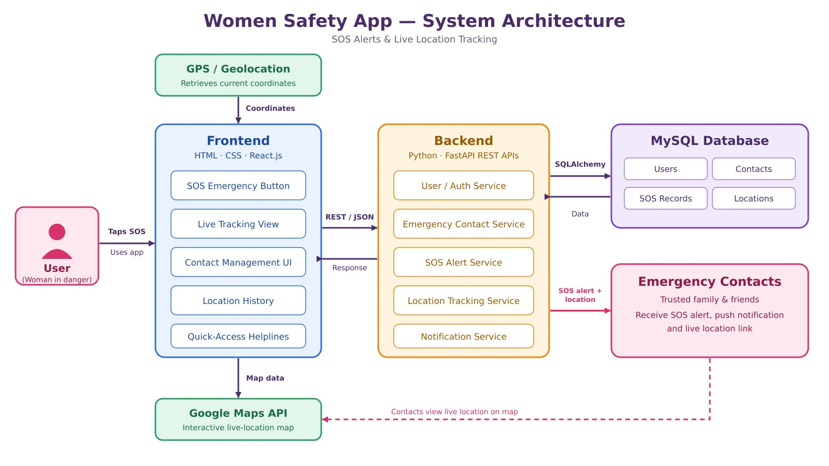










System Architecture
Frontend
Backend
MySQL Database
Emergency Contacts
HTML · CSS · React.js
Java · Spring Boot APIs
Users · Contacts · SOS · Locations
Receives SOS & Location Data
GPS / Location Services
Google Maps API
Frameworks & Platforms Used
HTML /
CSS
React.js
Java
Spring
Boot
MySQL
Google Maps
GitHub
Women Safety App — SOS & Live Tracking
6

Slide 7
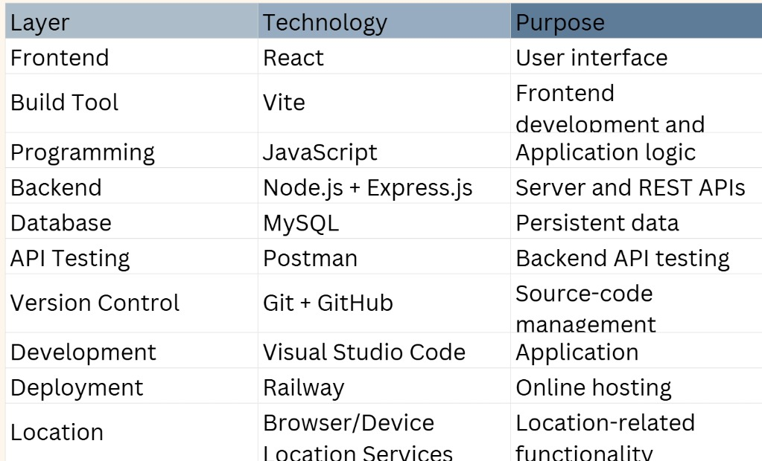
Technology Stack
Tools and frameworks powering the Women Safety App
Women Safety App — SOS & Live Tracking
7

Slide 8


Key Features
Core capabilities that make the app effective in an emergency
SOS Emergency Button
Live GPS Tracking
Emergency Contact Management
One tap sends an instant alert with live location to emergency contacts.
Trusted contacts can follow the user’s movement in real time.
Add, edit and organise a list of trusted people to notify.
Safety Notifications
Location History
Quick-Access Emergency Services
Instant push alerts keep contacts informed the moment SOS is triggered.
View past routes and locations for review or safety records.
Reach police or helplines directly from within the app.
Women Safety App — SOS & Live Tracking
8

Slide 9
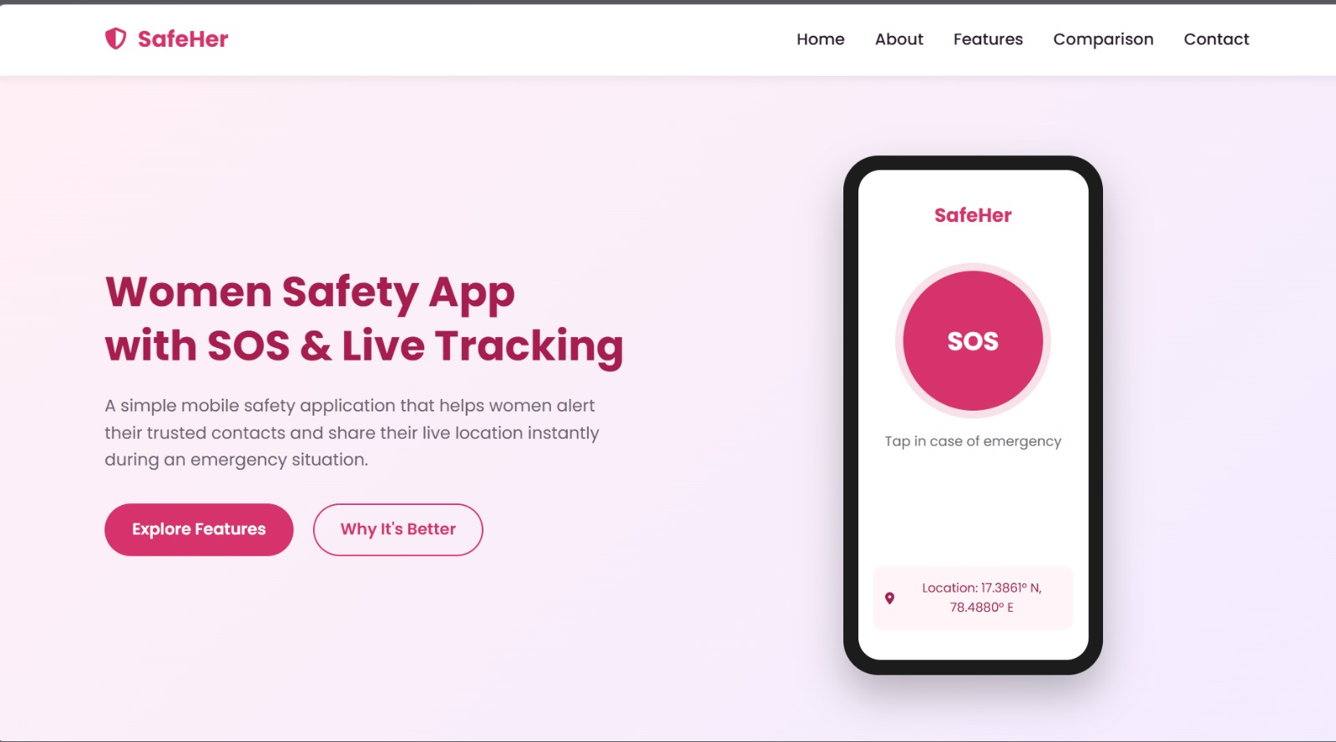
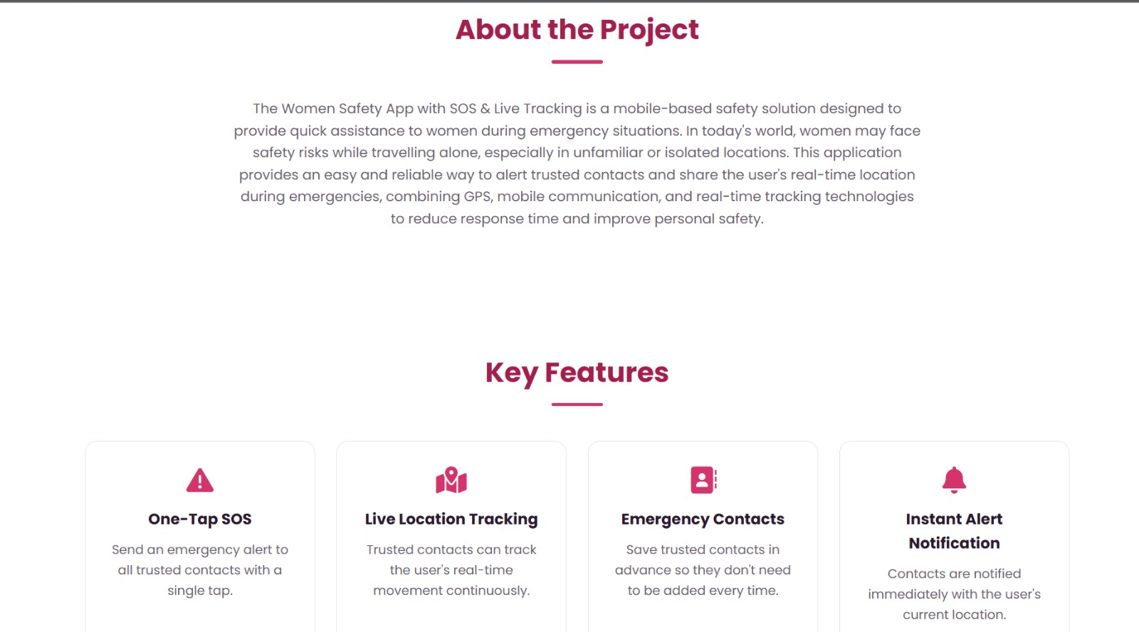
Application Preview
A look at the SafeHer app interface and website walkthrough
Home Page — SOS Interface
About the Project & Key Features
Women Safety App — SOS & Live Tracking
9

Slide 10
Conclusion
The Women Safety App brings SOS alerts, live GPS tracking and trusted-contact management into one accessible mobile solution.
It reduces emergency response time and removes the need to explain location verbally under stress.
By combining GPS, Firebase and real-time communication, it gives women greater confidence and security while travelling or staying alone.
Team Members
I. Nandini
Roll No: 2520090230
M. Niharika
Roll No: 2520090021
M. Sameeksha
Roll No: 2520090229
Thank You

